Slide 1




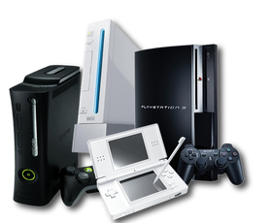

AMAZON PRODUCT REVIEWS
TOY AND GAMES REVIEW DATA
VIDEO GAMES REVIEW DATA
OUR TEAM
Rishabh Sharma
Abhishek Vasani
Tejas Swami

Slide 2




INTRODUCTION
Amazon,Inc. is an American based multinational electronics commerce company.
Headquartered - Seattle, Washington.
Within 26 years, Amazon became the world's largest online retailer and a household name. The Amazon name has become synonymous with online shopping and continues to grow by developing new products, acquisitions, and numerous service offerings to enlarge the customer base.
Reviews tell which products and features are trending, what's in demand, what's no longer relevant, how products and competitors are doing, and much more.
It's observed that a significant number of shoppers look at product reviews before they make a purchase. Survey results show that positive product reviews are a key factor for purchasing by 57 percent of Amazon buyers.

Slide 3

Project Objectives
Exploratory Data Analysis
During exploratory data analysis, we examined the data based on specific categories as well as multiple categories to compare the results and draw conclusions.
Sentiment Forecasting
In this chapter, we analyzed sentiments by employing appropriate algorithms to predict the sentiment in reviews.
Predictive Analytics
Using predictive analysis, we successfully forecasted the outcomes of reviewed products. Based on these forecasts, necessary steps can be taken accordingly.
Utilizing the predictions, forecasts, and clustering analysis,we pinpointed areas where customers were dissatisfied. Subsequently, we devised multiple strategies to segment the customers based on this information.
Customer Segmentation

Slide 4









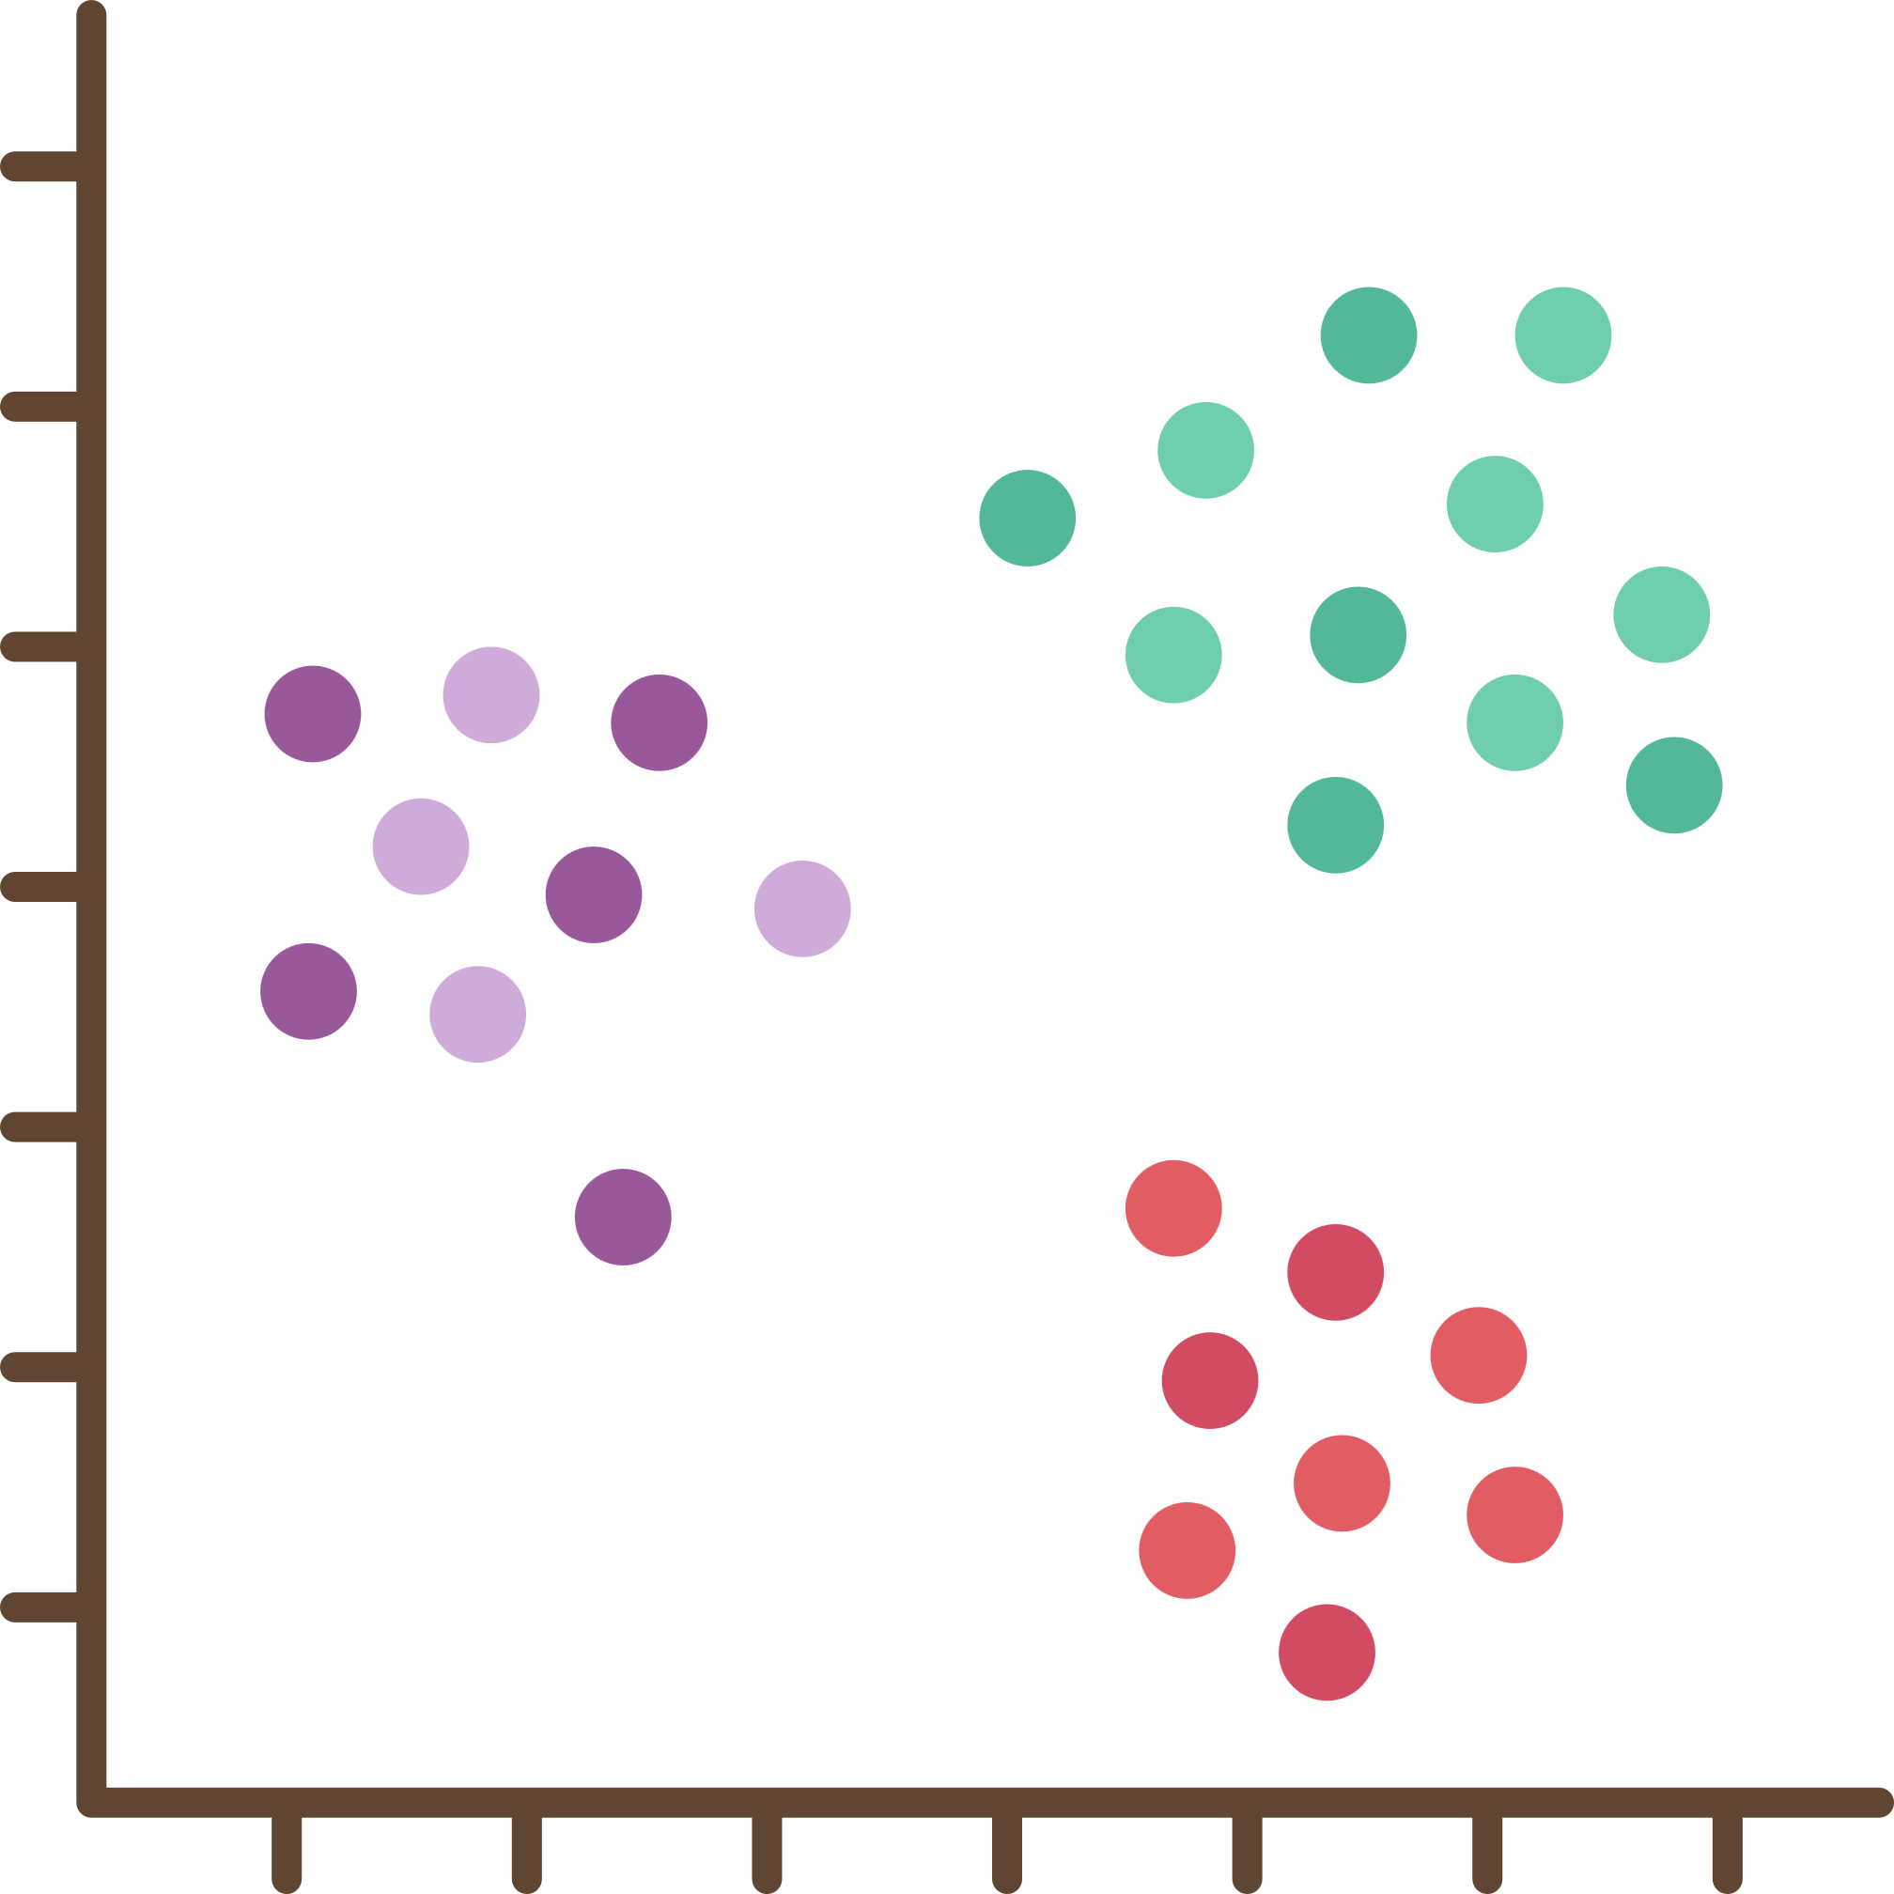
Project Flow chart
Preprocessing
Sentiment
Analysis
Classification
Data
Acquisition
EDA
API
Time-Series
Analysis
Clustering

Slide 5
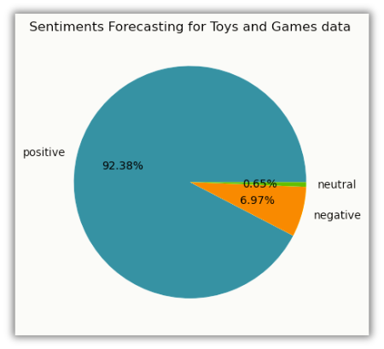

Sentiment forecasting
Data is heavily skewed towards positive sentiments, constituting 92% of the dataset, with neutral reviews making up less than 1%. This significant imbalance indicates that the Toys and Games dataset is skewed in favor of positive feedback.

Slide 6

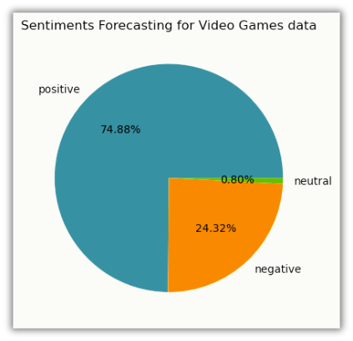
Sentiment forecasting
Majority of the data in the Video Games dataset consists of positive sentiments, accounting for 74.88%, while neutral reviews contribute to less than 1%. This substantial imbalance highlights a preference for positive feedback in the dataset.

Slide 7
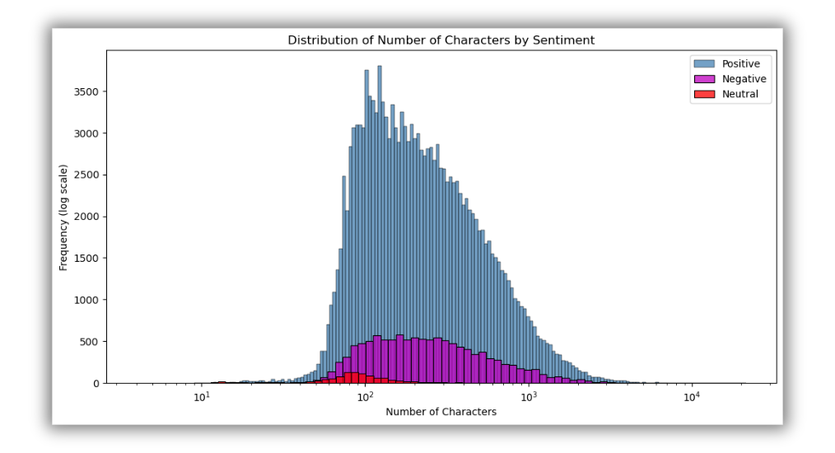
EDA
Character count wise sentiment for T&G data
Reviewers tend to write longer responses with positive sentiment, while they provide much shorter feedback for neutral sentiments.

Slide 8
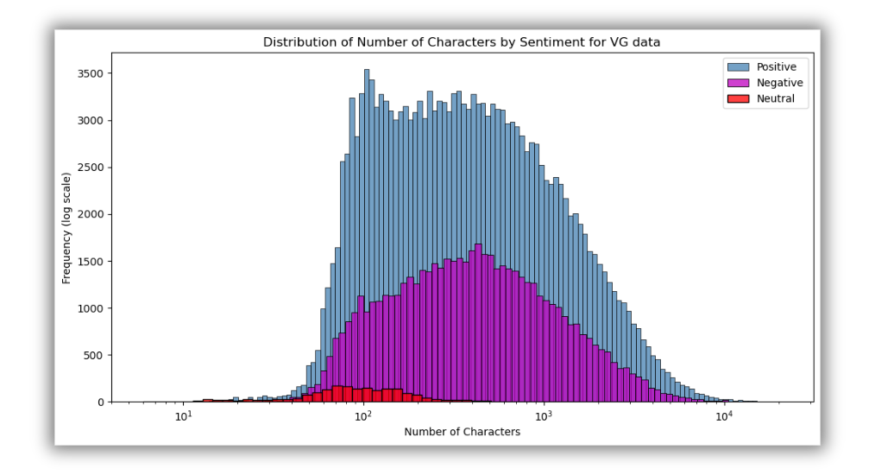
EDA
Character count wise sentiment for VG data
Reviewers tend to write longer responses with positive sentiment, while they provide much shorter feedback for neutral sentiments.

Slide 9
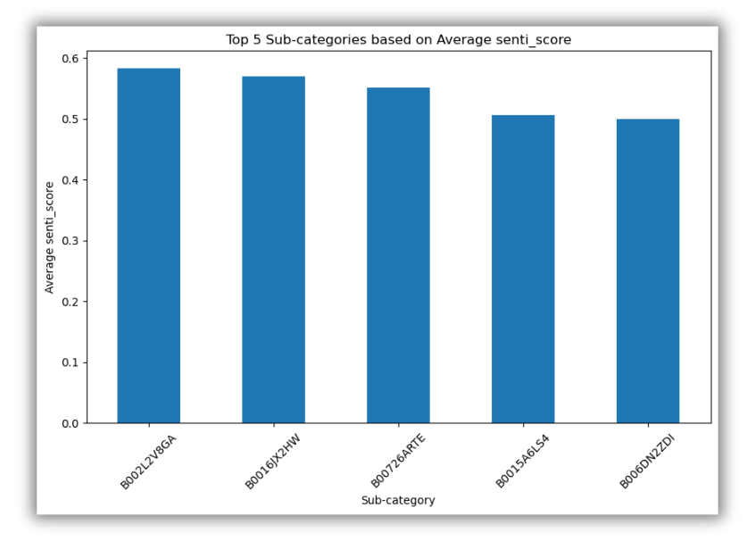
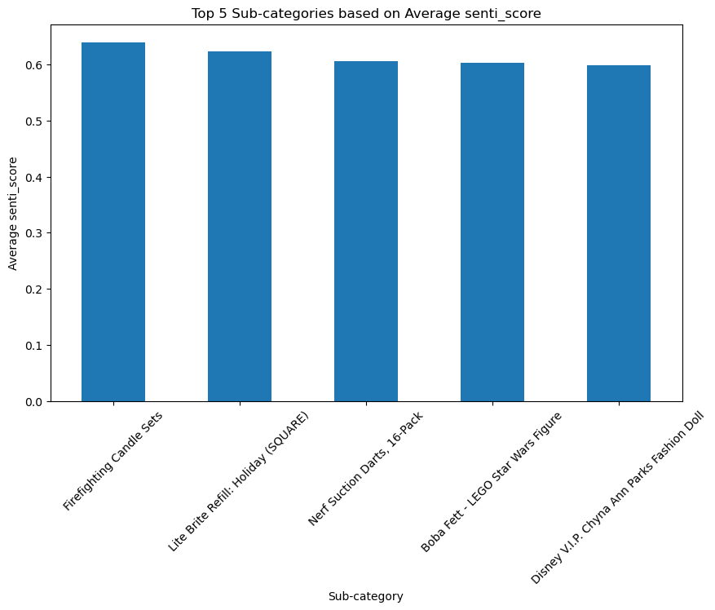
EDA
Top 5 product for Toys&Games
Top 5 product for Video Games
The "Firefighting Candle" sets stand out as the highest average positively rated product within the Toys & Games category. Meanwhile, the product with the ID "B002L2V8GA" claims the top spot as the most positively rated item in the Video Games dataset.

Slide 10
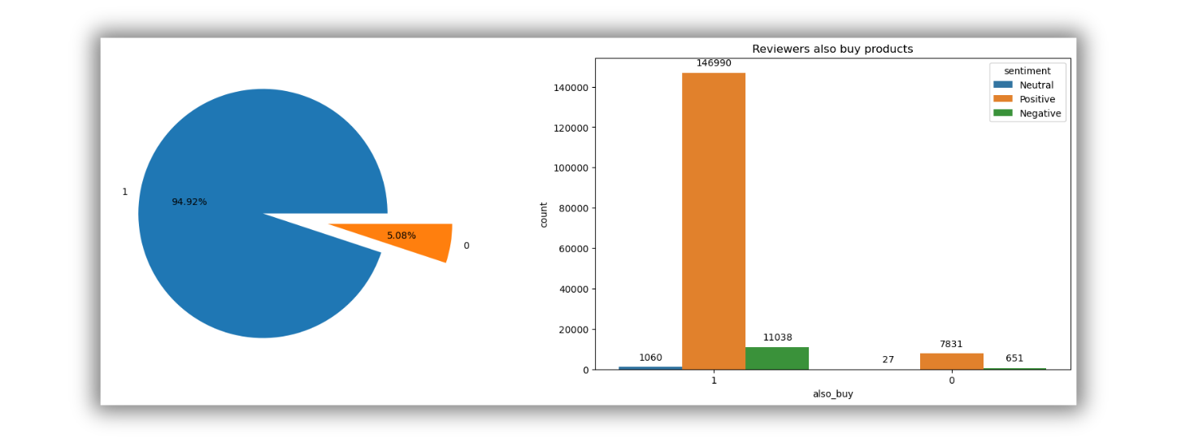
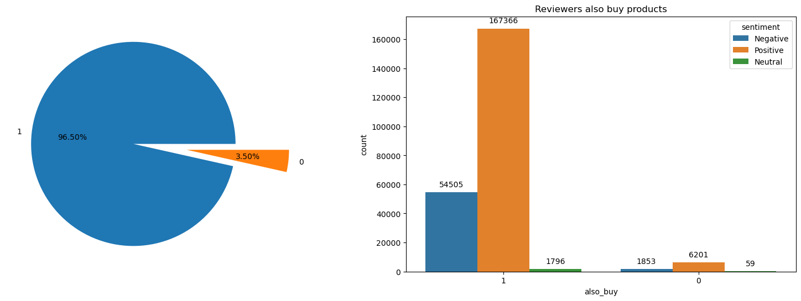
EDA
Multiple purchases for Toys&Games
Multiple purchases for Video Games
In both datasets, customers tend to buy multiple products instead of making single purchases in each order. When comparing the two datasets, reviewers who made multiple purchases in the toys and games category expressed higher satisfaction compared to those in the video games data.

Slide 11
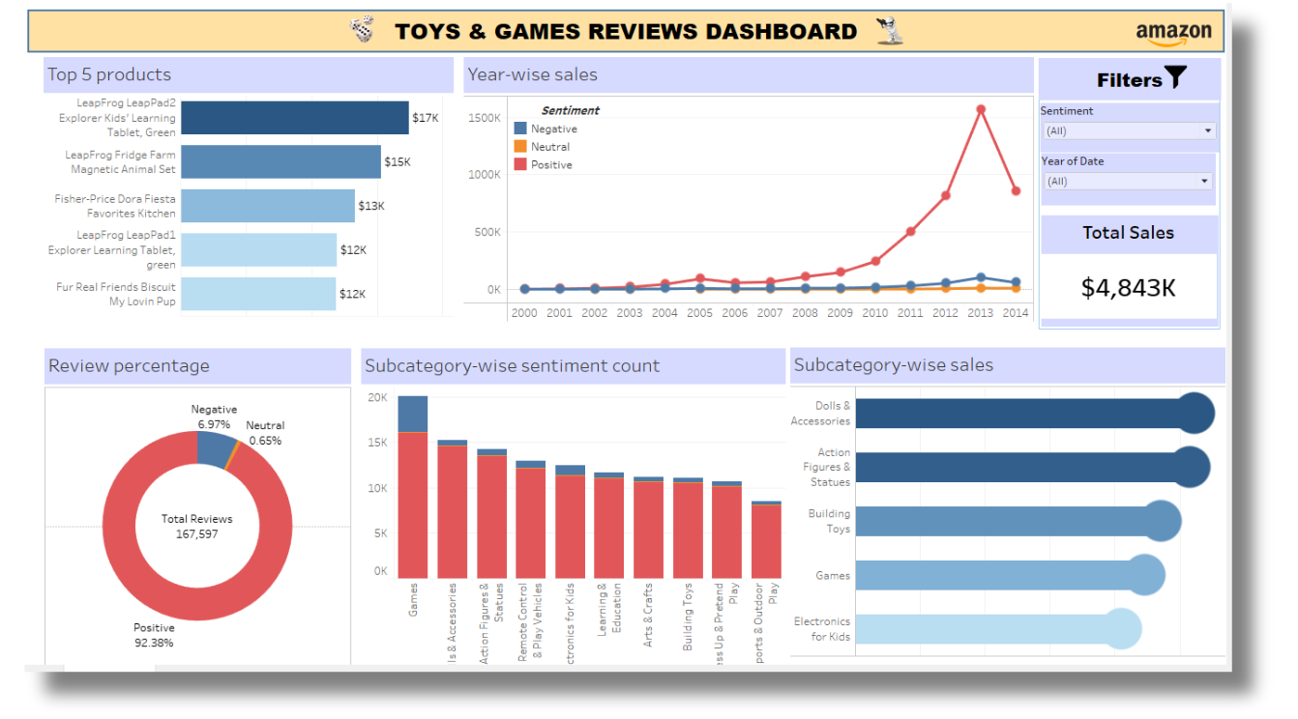
Tableau Dashboard for T&G DATA

Slide 12
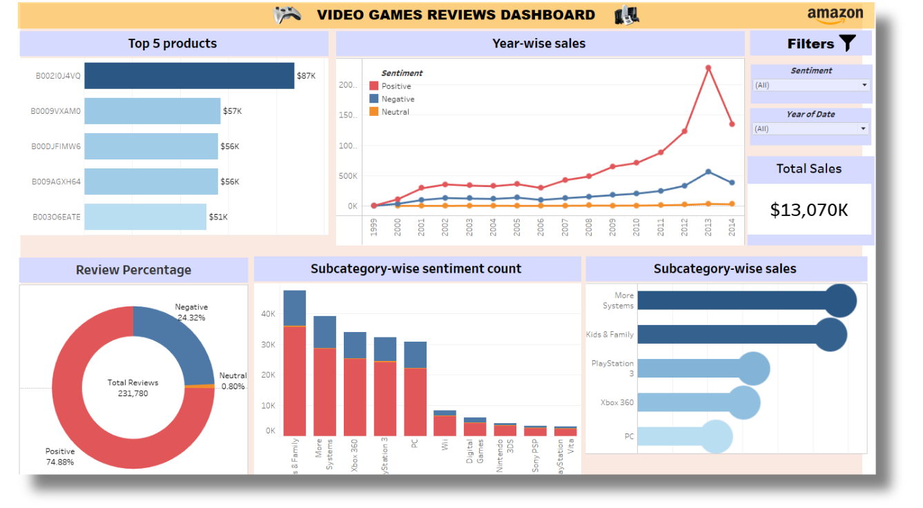
Tableau Dashboard for VG DATA

Slide 13
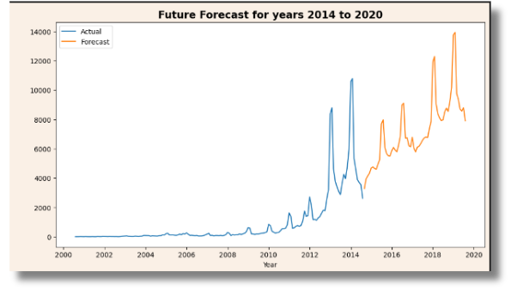
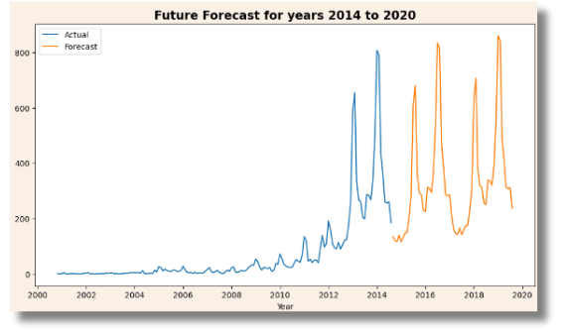
TIME SERIES
Positive Reviews for T&G Data
Negative Reviews for T&G Data
Positive reviews of the product show two significant peaks in 2018 and 2020, while negative reviews also shows peaks with sharp decline this suggests there is no significant change over time.

Slide 14
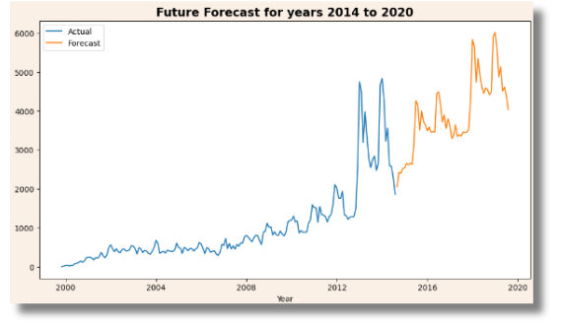
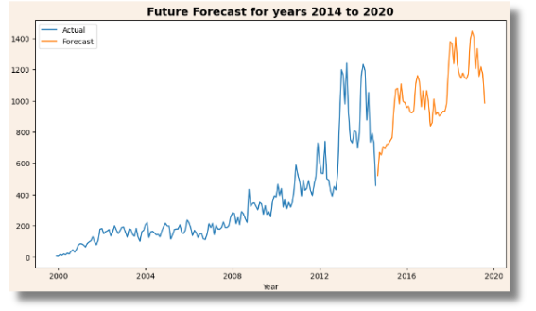
TIME SERIES
Positive Reviews for VG Data
Negative Reviews for VG Data
In both graphs, positive and negative reviews exhibit an upward trend, indicating a potential increase in the future.

Slide 15
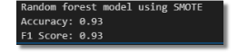
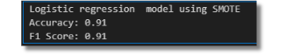
Classification
The preprocessed data exhibited imbalance, prompting the application of various techniques such as Class Weight and SMOTE to address this issue. We explored several models including Naive Bayes, Logistic Regression, and Random Forest to identify the most suitable one. Ultimately, the Random Forest model with SMOTE emerged as the optimal choice, delivering the desired results.
Best model after comparing all models for Toys & Games Data
Best model after comparing all models for Video Games Data

Slide 16
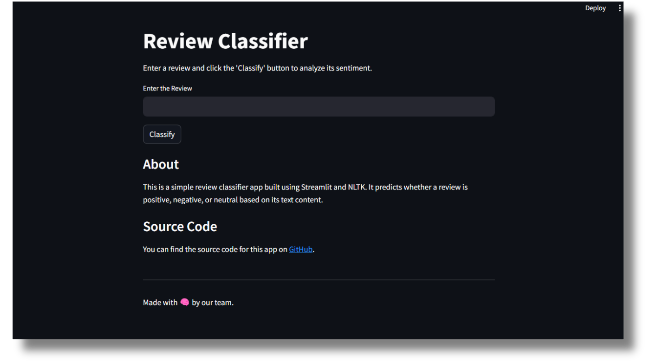
API for Review Prediction

Slide 17
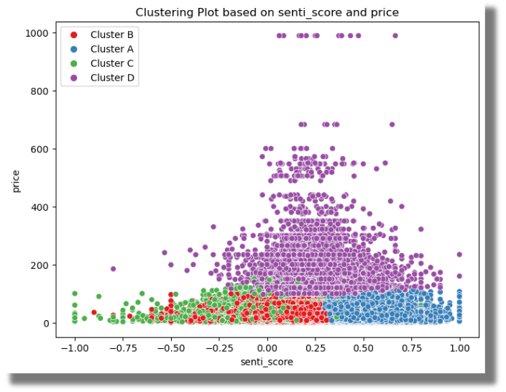
Clustering
Clustering on Toys & Games Data
"Cluster C" comprises the majority of unsatisfied customers, whereas "Cluster A" and "Cluster D" have the most satisfied customers. "Cluster B" falls into the category of average satisfaction.

Slide 18
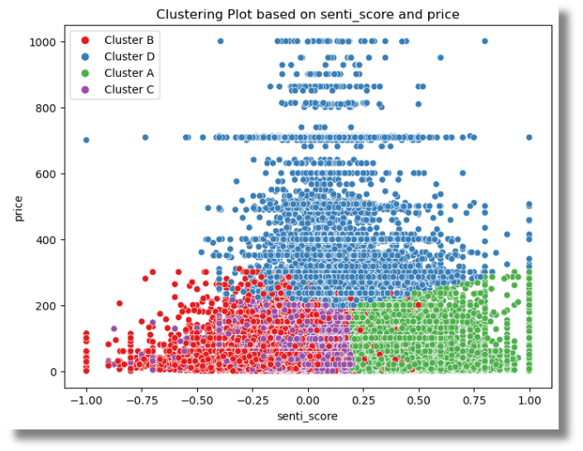
Clustering
Clustering on Video Game Data
"Cluster B" comprises the majority of unsatisfied customers, whereas "Cluster A" and "Cluster D" have the most satisfied customers. "Cluster C" falls into the category of average satisfaction.

Slide 19
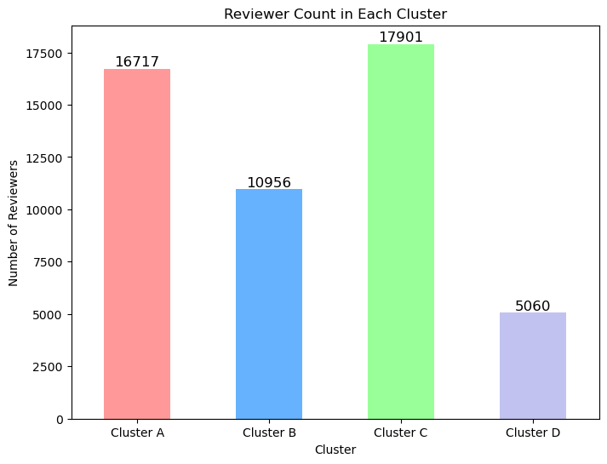
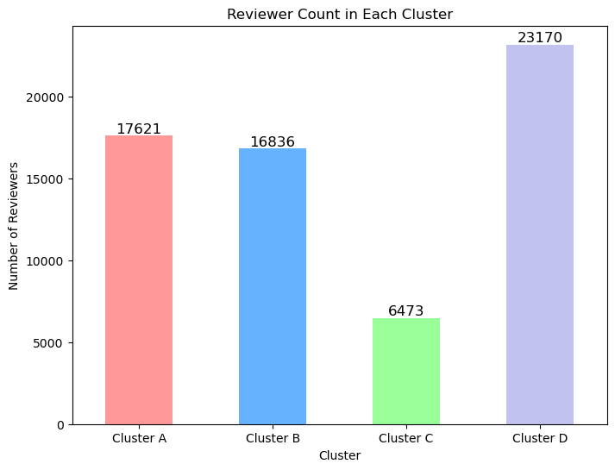
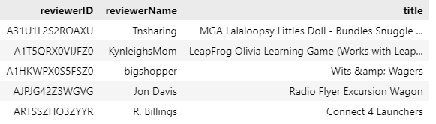
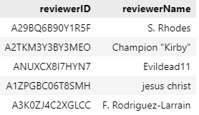
Final result Clustering
Toys & Games Data
Video Games Data
For Toys & Games “Cluster C“ showing count(17901) of unsatisfied reviewers and for Video Games data “Cluster B” showing count(16836) of unsatisfied reviewers.

Slide 20
Conclusion
Sentiment analysis indicates an imbalance in the data, suggesting a bias towards positive sentiments. By examining the chart, it becomes evident that the Video games category has a high number of dissatisfied reviewers.
Exploratory Data Analysis (EDA) shows that customers with neutral and negative sentiments tend to use fewer words in their reviews than customers with positive sentiments. Customers in both categories prefer to buy multiple products in each order. This suggests that customers who are unhappy with a product or service are more likely to write short, to-the-point reviews and they may also be less likely to buy additional products from the same company.
Based on the Time Series data, it can be concluded that the Toys&Games category outperforms the Video Games category.
Classification is used to identify the sentiment of upcoming reviews.through API. This information can be used to improve product performance and brand reputation. By identifying reviews that are likely to be negative, companies can take steps to address the underlying issues and improve the customer experience. This can lead to more positive reviews and a better reputation overall.
Through clustering, we performed customer segmentation and observed that clusters characterized by negative sentiment scores and lower pricing consist of the most dissatisfied customers, which could potentially result in customer churn.

Slide 21



Recommendations
We can offer discounts and promotions for sub-categories and products that are underperforming.This can help to boost sales and improve customer satisfaction in these areas.
Work with the particular unsatisfied customers shown in the clustering results. This could involve reaching out to these customers to understand their concerns and see if there is anything you can do to address them.
Continue to monitor customer sentiment and feedback. This will help to identify any emerging issues and take steps to address them before they become major problems.

Slide 22


Thank you

